Slide 1

Rutgers Bootcamp <section>
Group: Stephen McLaughlin, Raymundo Ojeda, and Kelly Quinn

Slide 2
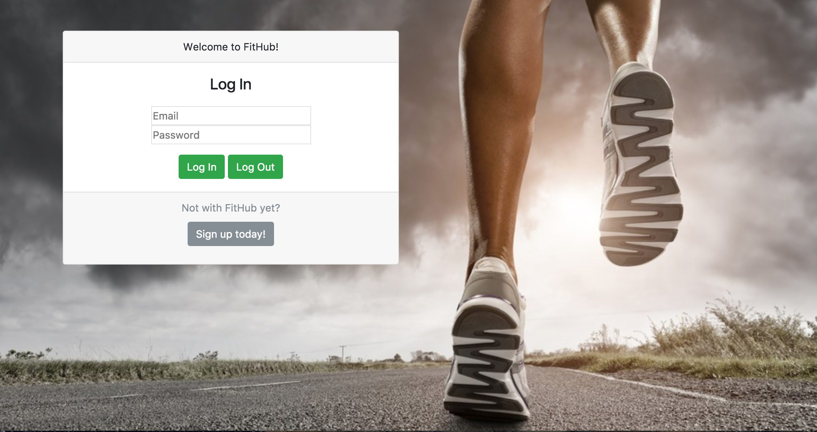
Why use FitHub?
“One stop shop”
Who is the ideal user of FitHub?
Resource management

Slide 3
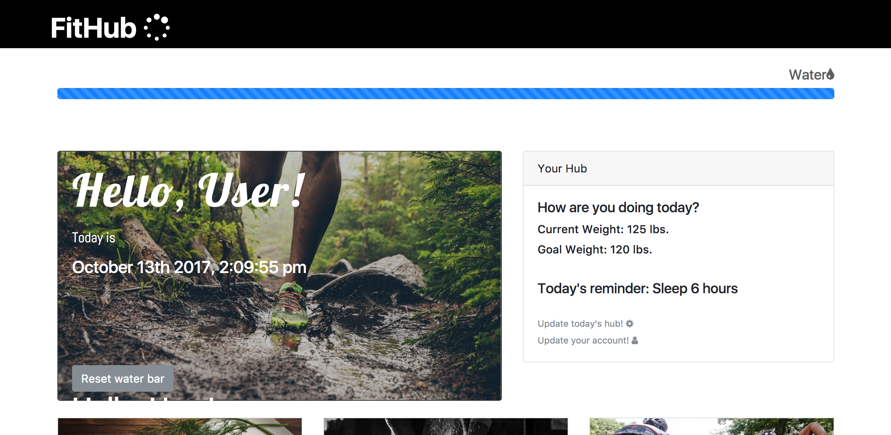
Solving this…
Provides an integrated platform
Exercise
Nutrition
Socialization
“Quick look” homepage

Slide 4



Steps to Build
My god, the APIs!
Nutritionix
Youtube
Meetup
Online Libraries
jQuery
Bootstrap 4.0 beta
Moment.js

Slide 5
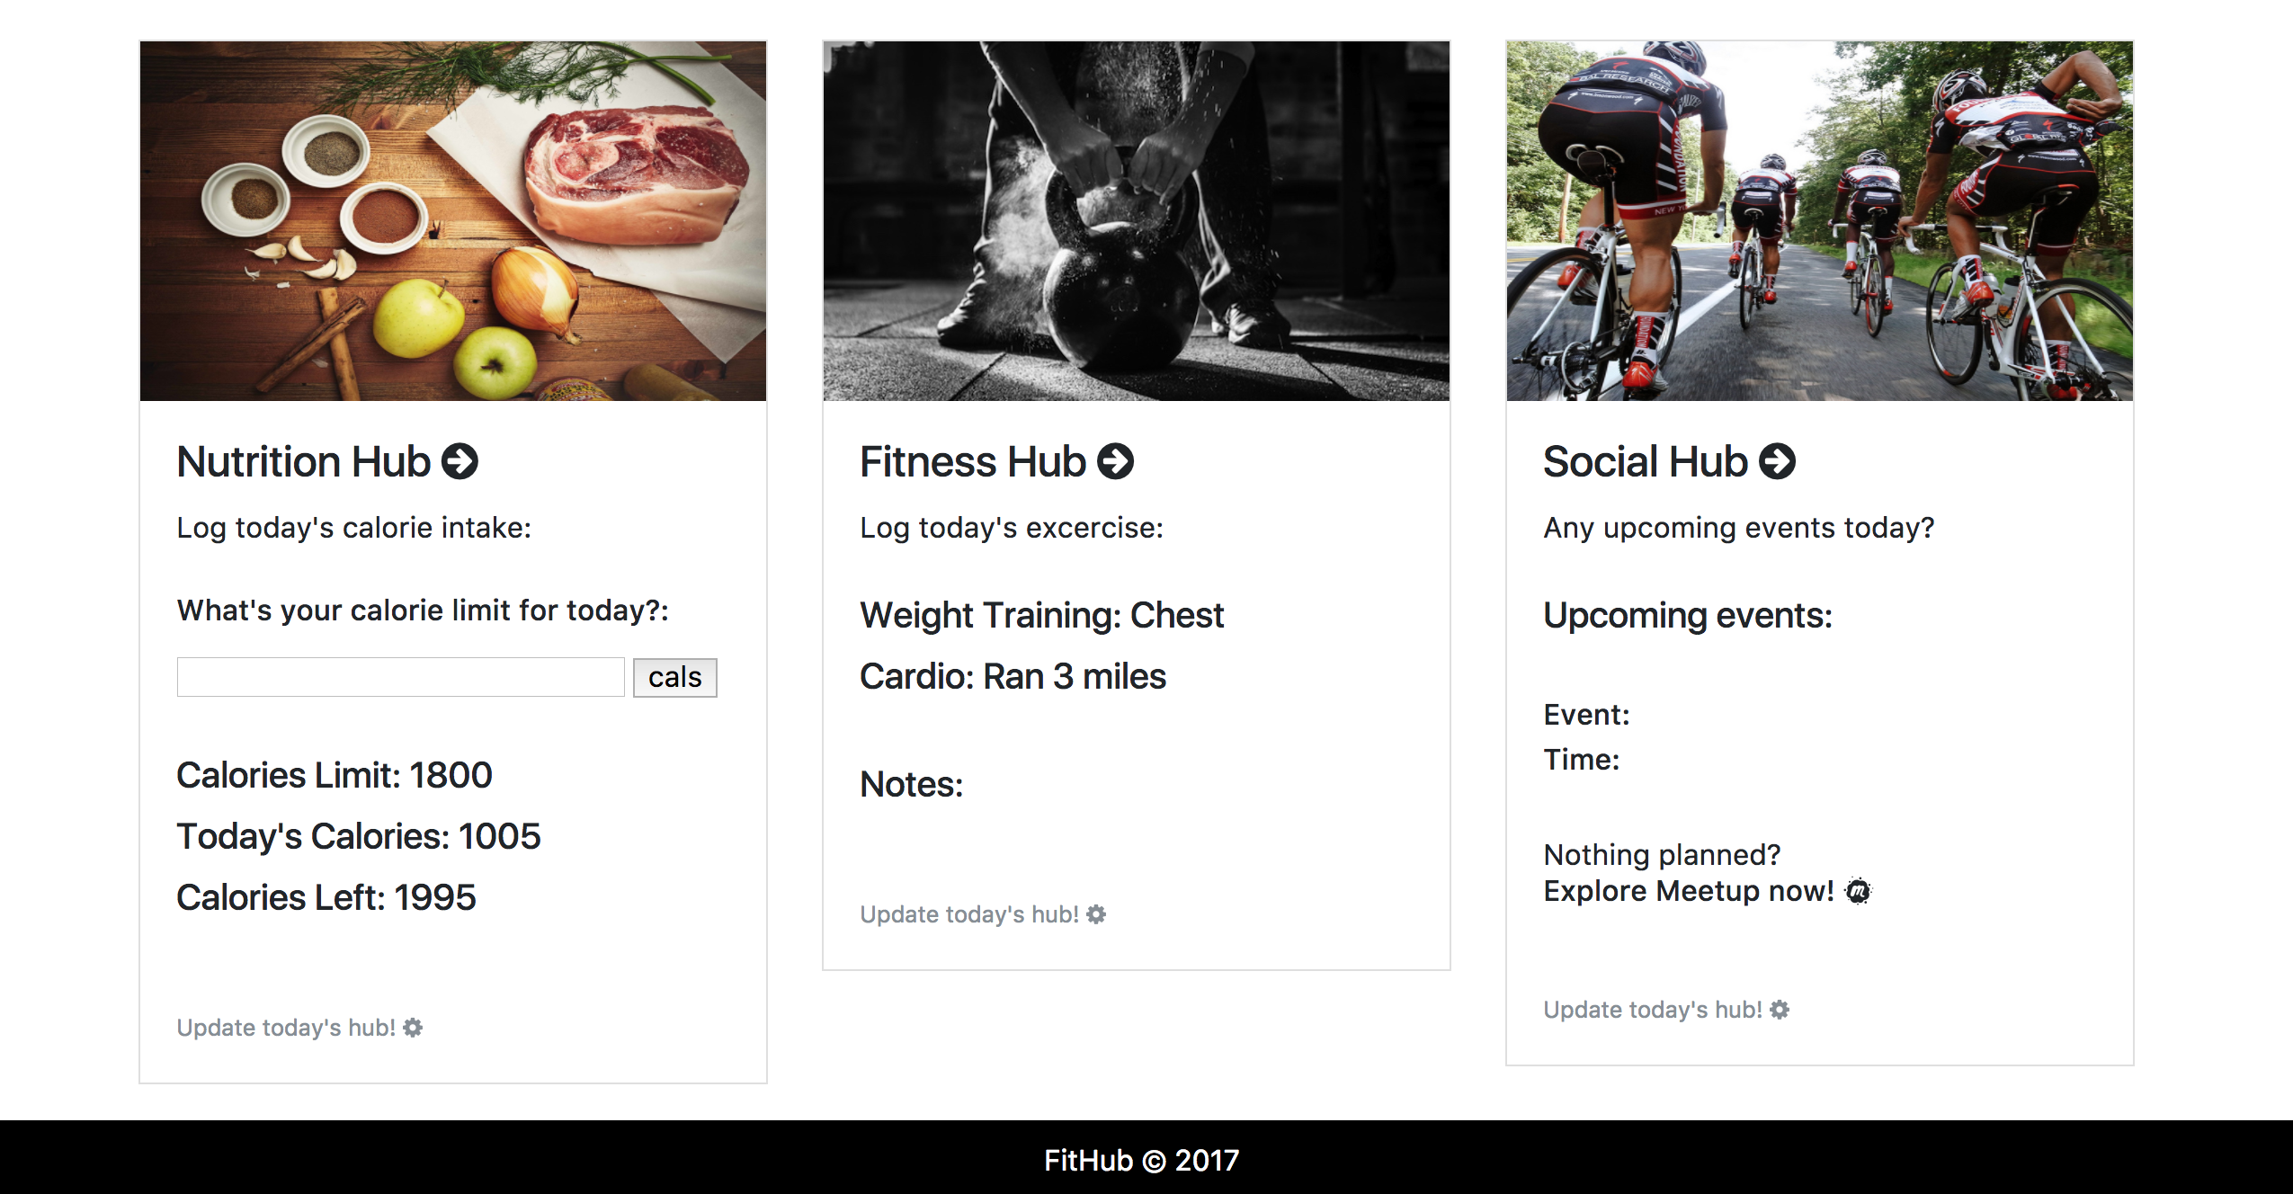
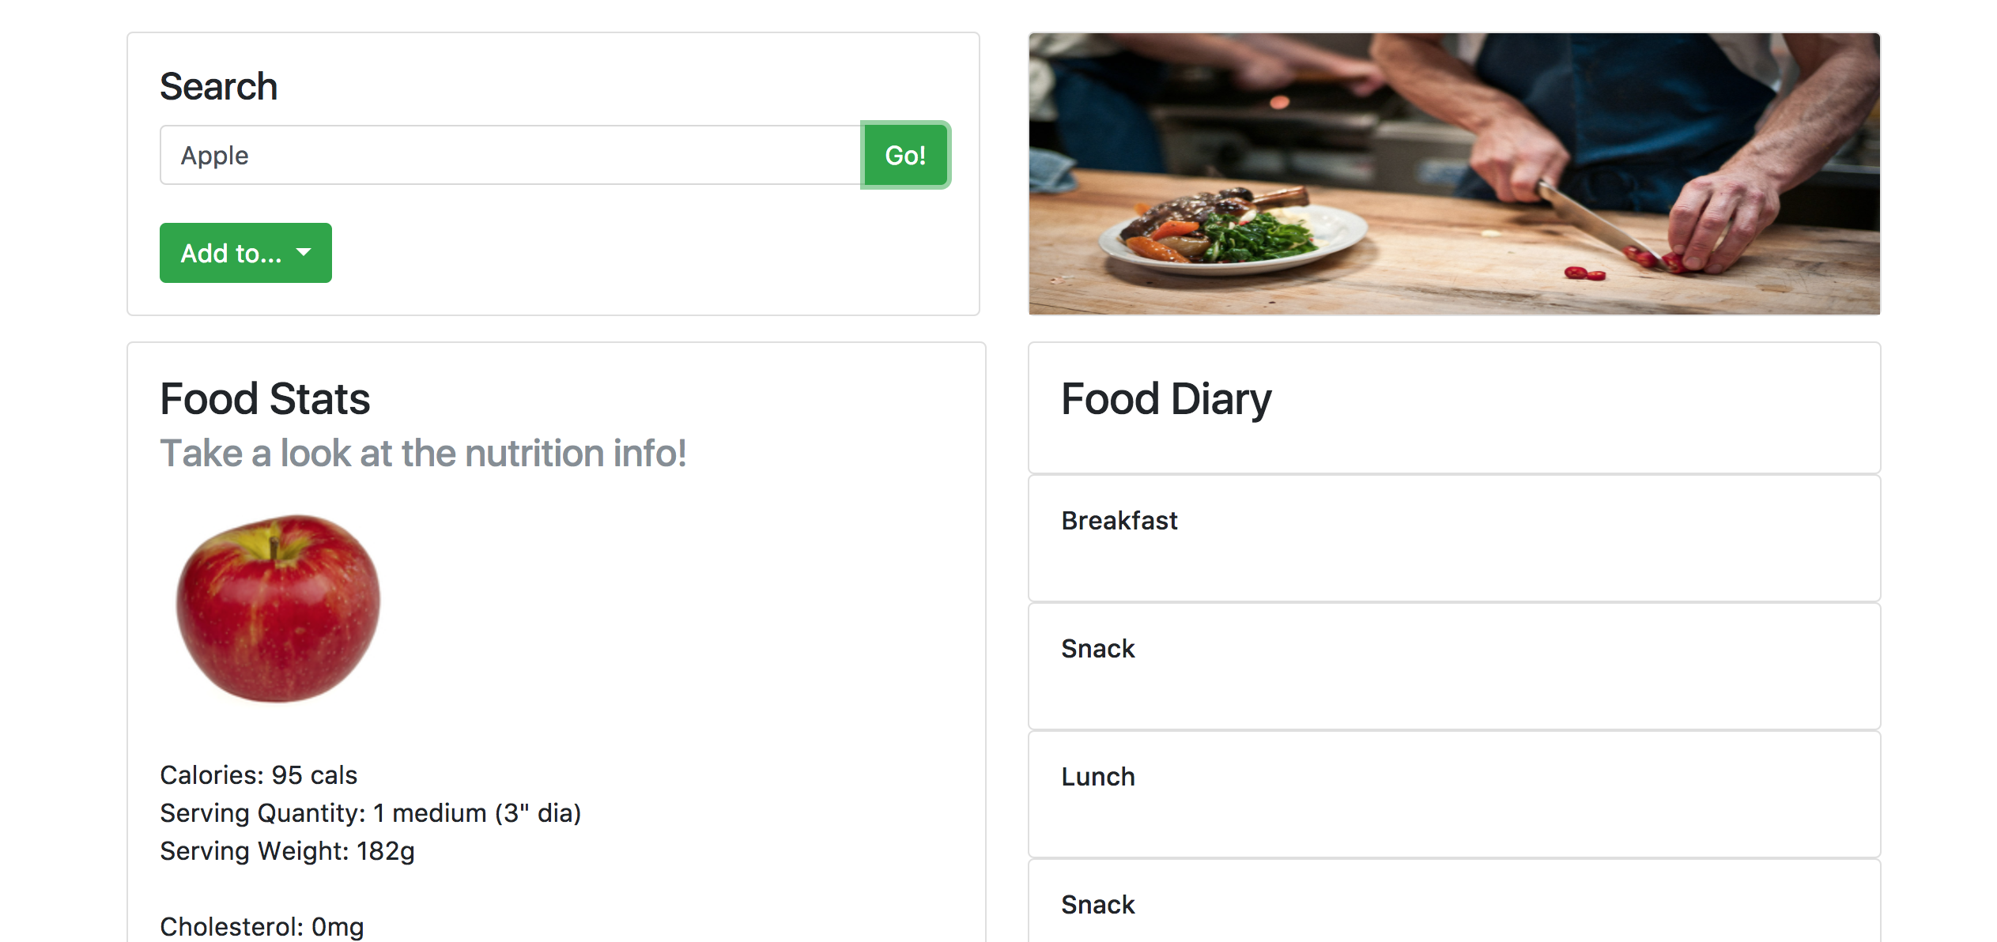
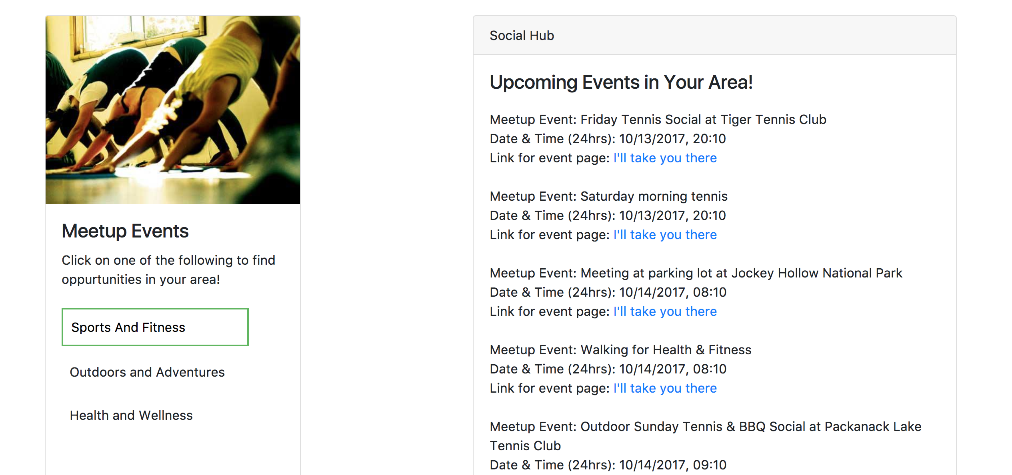
App Demonstration…

Slide 6
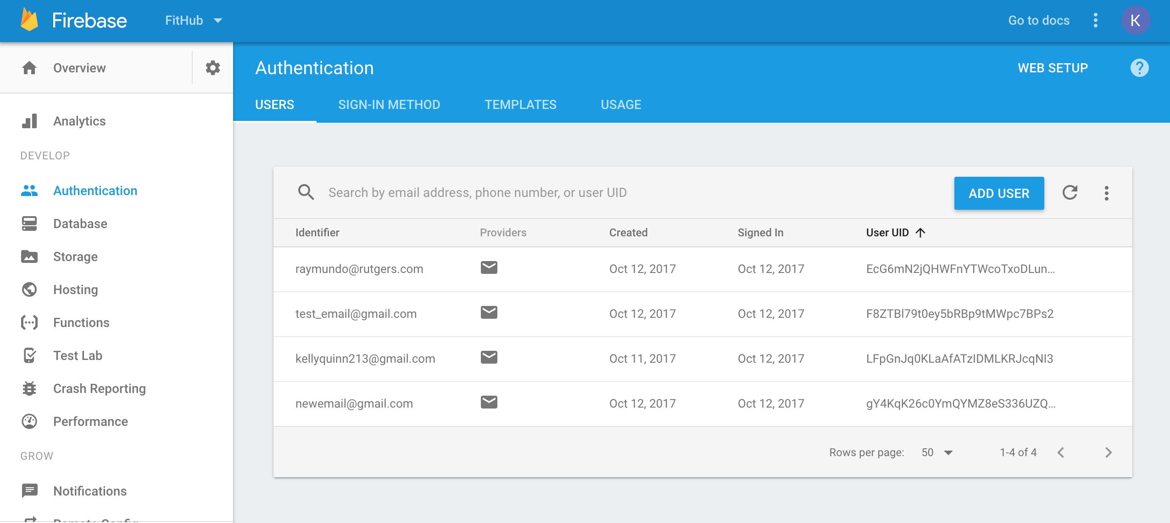
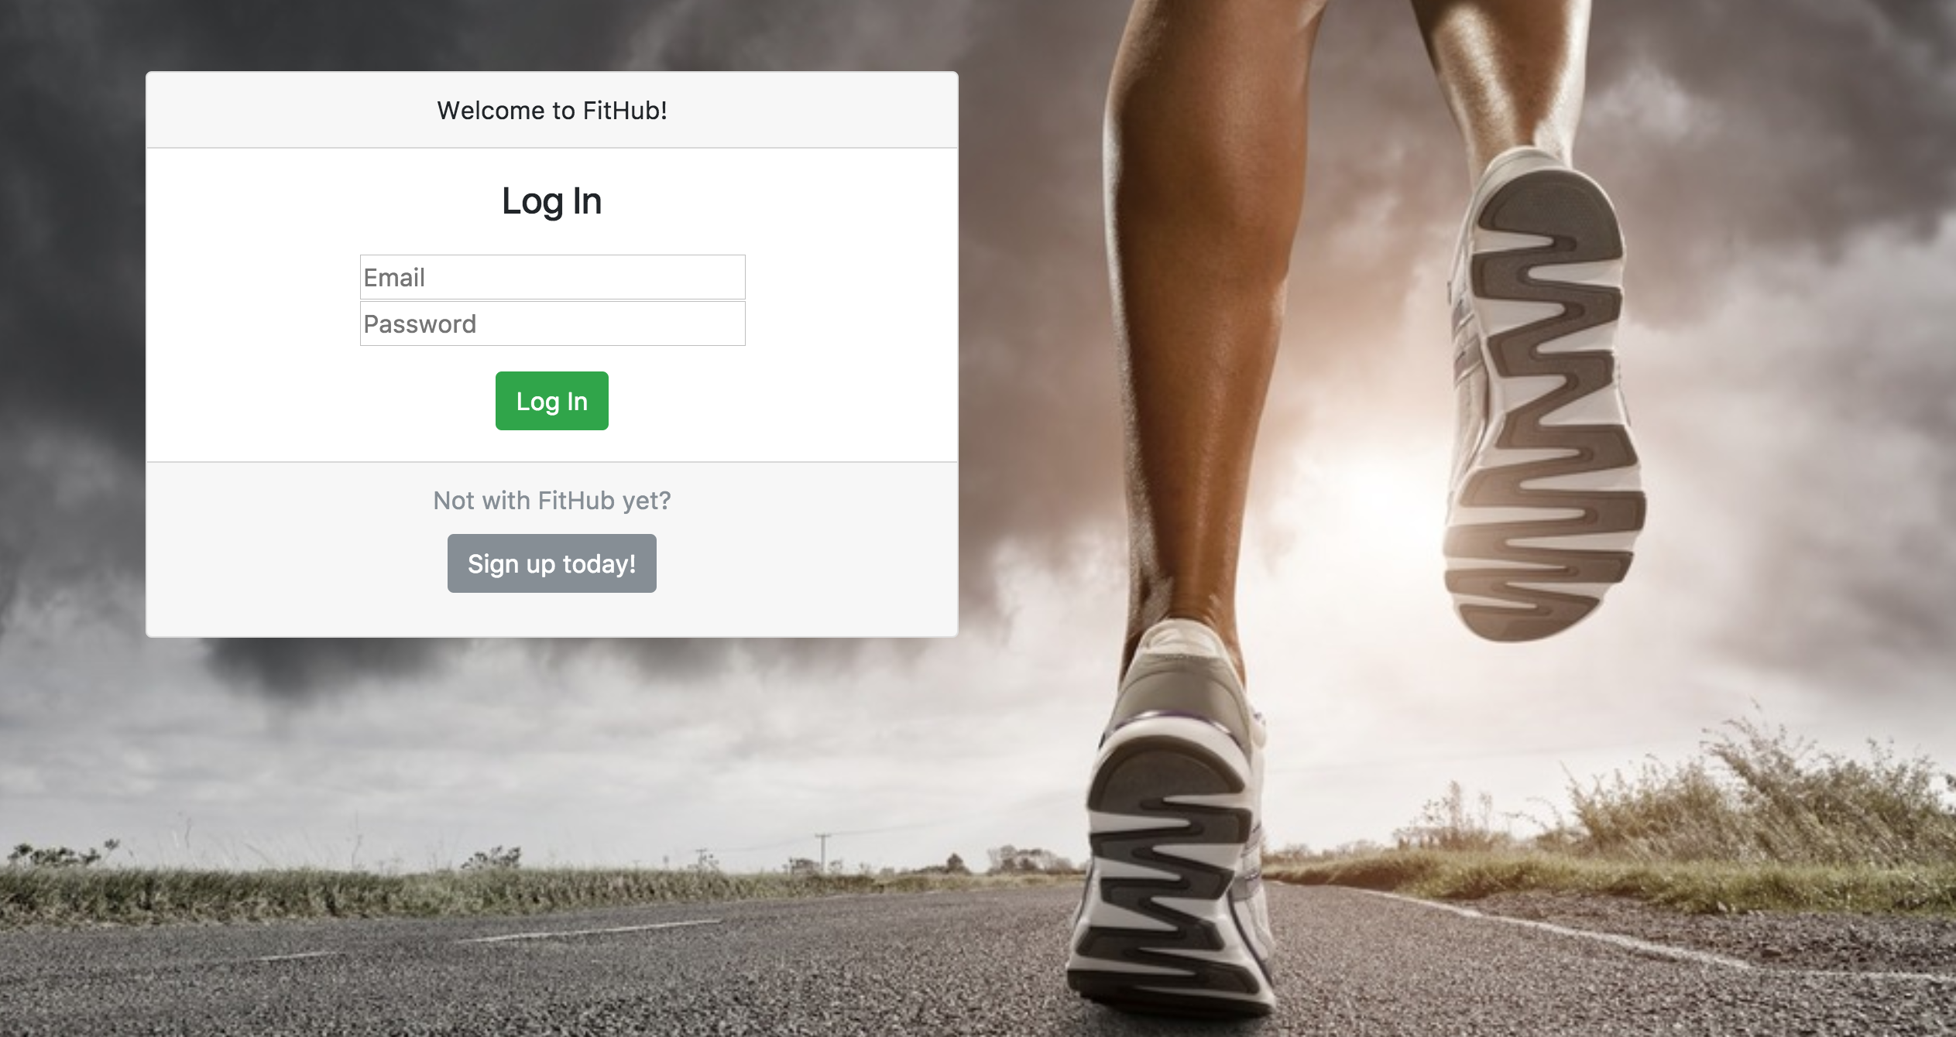
Updates
Firebase!
Master reset function
based on moment.js new date
Last login

